Slide 1



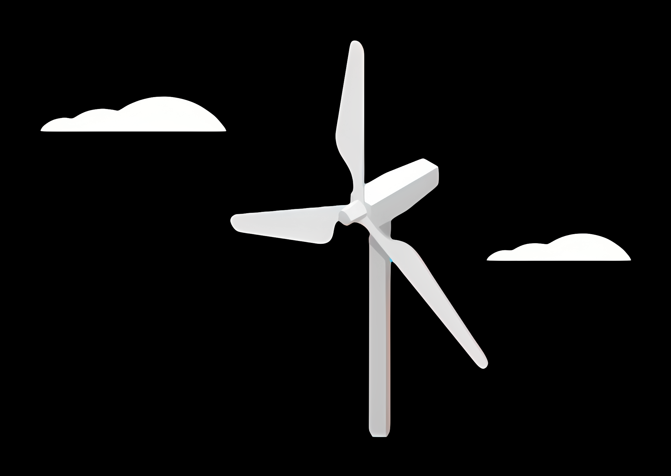
Weekly report: Project management
Week number: 01
Date: 23/09/2025
Supervisor: Prof. Manjock
Group members: Mohamed Alywa, Abdelrahman Abdelaziz , Paresh Nakum

Slide 2
Agenda
Guidelines Used in Syria
Typical load output sections
Design situations
Simulation Workflow
Needed parameters for the pre-processing
Coordinate systems and components
Estimated Loads for Optimus Syria

Slide 3
Guidelines Used in Syria
The wind turbine model shall possess a valid type certificate issued by any internationally accredited type certification body as per IEC /GL type certification scheme, along with certified power curve.

Slide 4
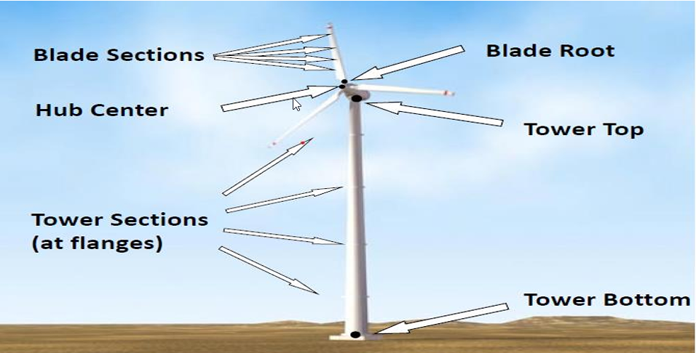
Typical load output sections
Load Output Sections Representation

Slide 5
Design situations
Power production (DLC 1.X)
Power production + occurrence of fault (DLC 2.X)
Start up (DLC 3.X)
Normal shutdown(DLC 4.X)
Emergency stop (DLC 5.1)
Parked: Standing still or idling (DLC 6.X)
Parked and fault conditions (DLC 7.X)
Transport, installation, maintenance and repair (DLC 8.X)

Slide 6
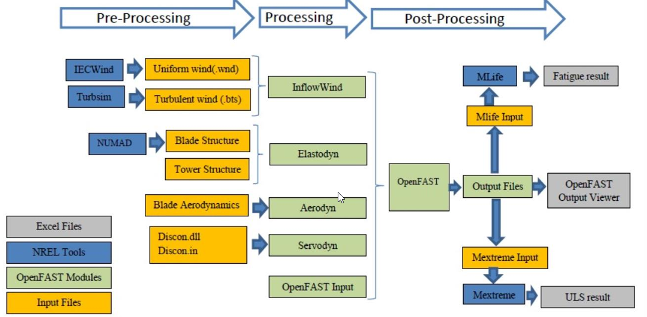
Simulation Workflow
Simulation Workflow

Slide 7
Needed parameters for the pre-processing
Site assessment:
Wind speed
Wind direction
Air density
Tower:
Tower height
Mass distribution
Stiffness
Natural frequencies
Rotor blades:
Mass per unit length
Bending stiffness
Torsional stiffness
Natural frequencies
Material properties
Lift coefficient (Cl) and Drag coefficient (Cd) as functions of the angle of attack (AoA).
Blade twist and chord distribution along the blade.
Tip loss and hub loss correction factors
Mass and inertia :
Yaw bearing
Nacelle Hub
Nacelle inertia about yaw axis
Control:
Pitch control gain values.
Generator torque control settings.
Set points for turbine operating conditions
Yaw control settings

Slide 8
Coordinate systems and components
Coordinate system | Affected components
Blade coordinate system | Rotor blade Rotor hub, Pitch system
Chord coordinate system | Rotor blade
Hub coordinate system | Rotor hub, Pitch system Rotor bearing system Gearbox, Brake, Coupling Machine Bed, Yaw system
Tower top coordinate system | Machine Bed, Yaw system Tower & Foundation
Support structure (tower) coordinate system | Tower & Foundation

Slide 9
Estimated Extreme Loads for Optimus Syria
All listed values represent extreme loads (ULS) and already include the corresponding partial safety factors (γF).
 | Blade Edge moment | Blade Flap moment | Rotor thrust | Yaw Bearing Tilt moment | Rotor torque | Tower-bottom | Diameter | rated Power
 | kNm | kNm | kNm | kNm | kNm | kNm | m | KW
Optimus150 WS15 | 30,103 | 26,341 | 1,535 | 18,793 | 6,941 | 256,308 | 150 | 3,500
Optimus150 WS16 | 12,413 | 26,770 | 1,737 | 20,817 | 7,925 | 284,580 | 150 | 3,500
Optimus200 WS17 | 39,052 | 100,649 | 4,503 | 57,713 | 27,729 | 681,780 | 200 | 10,000
Optimus Oceanus | 52,998 | 116,570 | 4,872 | 103,990 | 49,073 | 1,189,800 | 255 | 17,000
Optimus92LE WS19 | 3,074 | 8,184 | 630 | 5,082 | 3,194 | 64,590 | 92 | 2,000
Optimus92LE WS20 | 4,070 | 7,495 | 764 | 8,432 | 2,471 | 86,020 | 92 | 2,000
Optimus60E WS21 | 2,204 | 1,872 | 304 | 1,708 | 2,005 | 28,567 | 60 | 750
Optimus Syria | 8,854 | 16,044 | 1,153 | 15,922 | 8,750 |  | 122 | 5,000

Slide 10
References
Reports of the previous projects
Loads and site conditions for wind turbines, DNVGL-ST-437,Edition November 2016

